Slide 1
2.2 Assessing Model Accuracy
October 17, 2014

Slide 2
Measuring Quality of Fit
How well do our predictions match what is truly observed?
Specifically does the outcome we see in the training data match what we see in unseen test data?
Example: We want to predict how many influenza admissions to the emergency department for this flu season.
Prediction model will use training data from prior influenza seasons
But will it work for the current influenza season? And how well?
Could we test the model on the first month in flu season then adjust as needed?

Slide 3


Mean Squared Error (MSE)
One method of determining the best model to use.
Most often used in regression settings
Goal: Choose a model with the lowest test MSE
Better than the model with the lowest training MSE
= Prediction that gives for the i^{th} observation
In other words, does our prediction from training data work for new and unseen data?

Slide 4
MSE, continued…
Two different MSE: training and test
Training: Data we already have
Test: Future data (data we can use to check our training results)
#1 Goal is to have a low MSE in our test data
Training MSE will decline as model flexibility increases
So…how does this all work?

Slide 5
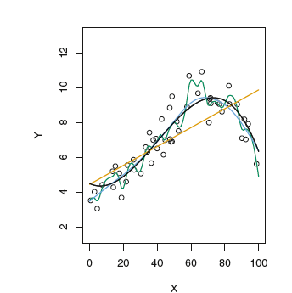
MSE Example: data first!
Black Curve = True F
Green Curve = Smoothing Spline
Model Flexibility
Blue Curve = Smoothing Spline
Orange Curve =
Linear Regression Fit
O = Test data

Slide 6
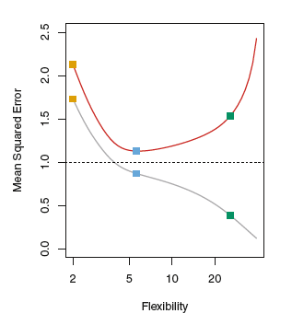
MSE Example
Red Curve = Test MSE
Dashed Line =
Minimum possible MSE
Var(ε) – irreducable error
Grey Curve = Training MSE

Slide 7
MSE Example: Training MSE
Grey Curve = Training MSE
Lowest MSE
Notes:
Remember this is data we already have

Slide 8
MSE Example: Test MSE
Red Curve = Test MSE
So now we see that when using our three prediction methodologies our BLUE (smoothing spline) model has the lowest MSE.
Notes:
Now this is our new data. And how do our models work?

Slide 9
MSE Example: Overfitting the data
Using the training data, the green model had the lowest MSE but this was not true for the test data.
This happens because the model is working too hard to fit the training data.
We are picking up patterns due to random chance instead of the true pattern of f

Slide 10
MSE: Caveat
We do not usually have “test” data.
We typically have training data and then have to use our model to predict outcomes
In future chapters we will learn how to estimate training MSE

Slide 11

Bias-Variance Trade Off
Expected test MSE
Variance of
Variance of bias
Variance of error terms
=
+
+
The expected test MSE = average of repeated estimates of f using many large training datasets

Slide 12
Bias-Variance Trade Off
Want a model with low variance and low bias
Variance = amount which would change if we used a different training dataset
Model Flexibility
=
Variance
Notes:
A method with high variance will lead to small changes in training data lead to large changes in f

Slide 13
Bias-Variance Trade Off
Want a model with low variance and low bias
Bias = error that is introduced by trying to look at a “real-life” problem
Model Flexibility
=
Bias

Slide 14
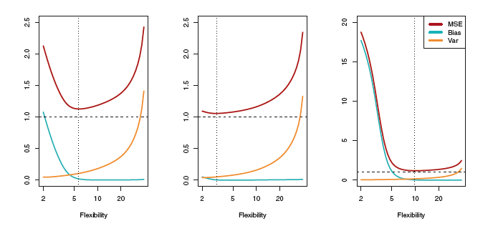
Bias-Variance Trade Off
When using training data it is important to find a method with low variance and low squared bias
Remember: just because a model eliminates bias, doesn’t mean it will perform better than a simpler model

Slide 15
Bias-Variance Trade Off
This is the bias and variance from our example from earlier.
For different levels of flexibility, we see a change in:
Squared bias (blue)
Variance (orange)
MSE (red)
As flexibility increases:
-Blue Curve = Bias initially decreases rapidly
-Red Curve = Test MSE sharp decline then increase
Orange Curve = Variance rises slow then steep incline
Smallest Test MSE
Irreducable error
Ideal flexibility based on the MSE

Slide 16

The Classification Setting
Used when y_{i} is no longer numerical
What if the training observations are qualitative?
We then need to find the training error rate (fraction of incorrect classifications)

Slide 17

The Bayes Classifier
Error rates from the classification setting can be minimized by using a probability
We will assign each test observation to the MOST LIKELY class given its predictive values (from the training data)
This is a conditional probability
Class assignments will be made based on whether Pr>0.5 or Pr<0.5

Slide 18
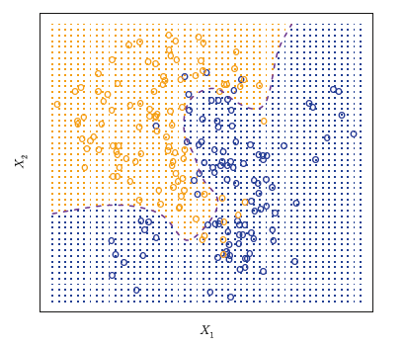
The Bayes Classifier
Bayes Decision Boundary:
Pr=0.5
Orange =
Pr(Y=orange|x)>0.5
Blue =
Pr(Y=blue|x)<0.5

Slide 19
The Bayes Classifier
Requires the conditional distribution of Y given X, which is something we do not know
It is therefore an:
Impossible Gold Standard

Slide 20
K-Nearest Neighbor
Attempts to estimate the conditional distribution of Y given X with an estimated probability
Use this because we cannot use Bayes

Slide 21
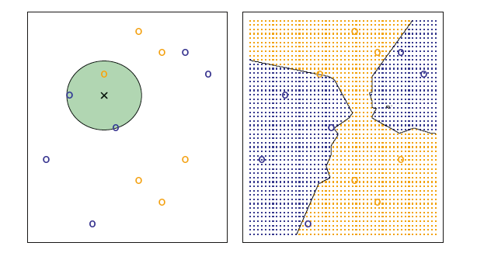
K-Nearest Neighbor
Black Line = KNN decision boundary
We want to make a prediction about x
K = 3 for all values of X₁ and X₂
Since K=3 the three closest points to X are chosen
Therefore, the test observation is predicted to the most commonly occurring class: BLUE
Notes:
Which color shows up most in the circle?

